Slide 1
Software Design & Development CFS2160
Week 14 – Understanding a Question

Slide 2
Session plan
Look at how we can understand the tutorial questions.
Questions?
Continue to work on any outstanding practical work.

Slide 3
Understanding a question
You may have noticed we pose questions that can be a bit vague, there is a reason for this. We want you to think about the work you are doing before you start coding (modelling).
Understanding what you need to do is crucial to answering the question.
Re-using existing code without the knowledge of what it does will most likely end up taking more time than writing it from scratch. Take the time to understand what the code examples do and how they work.
The following slides give hints on how to identify what you are required to do (a design pattern).

Slide 4
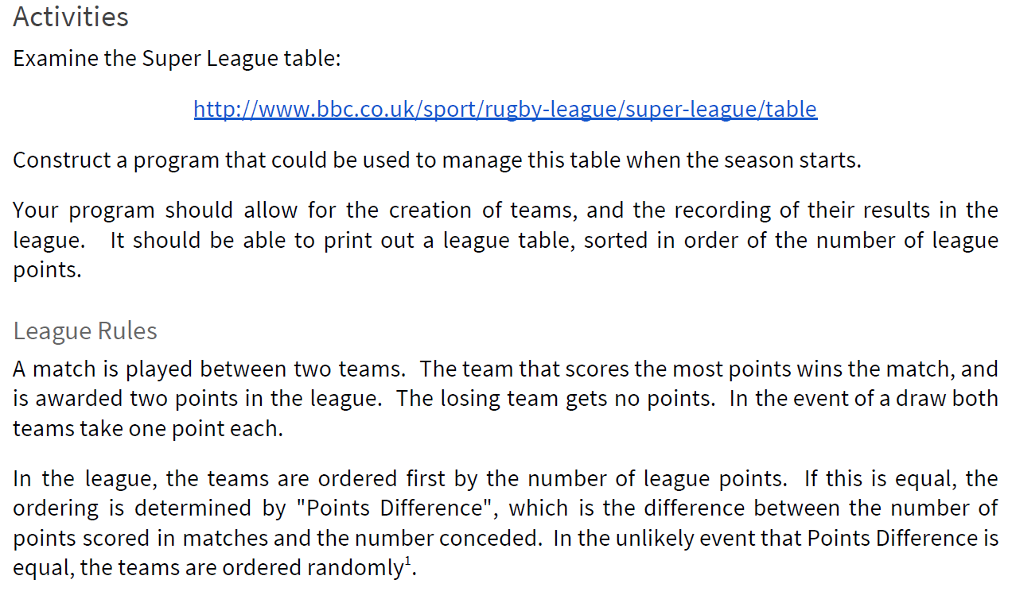
Carefully read the tutorial question
Look at the website suggested, it will show detail of what is expected
Gives us an indication of how the scores need to be calculated
Tells us how to order the teams in the league

Slide 5
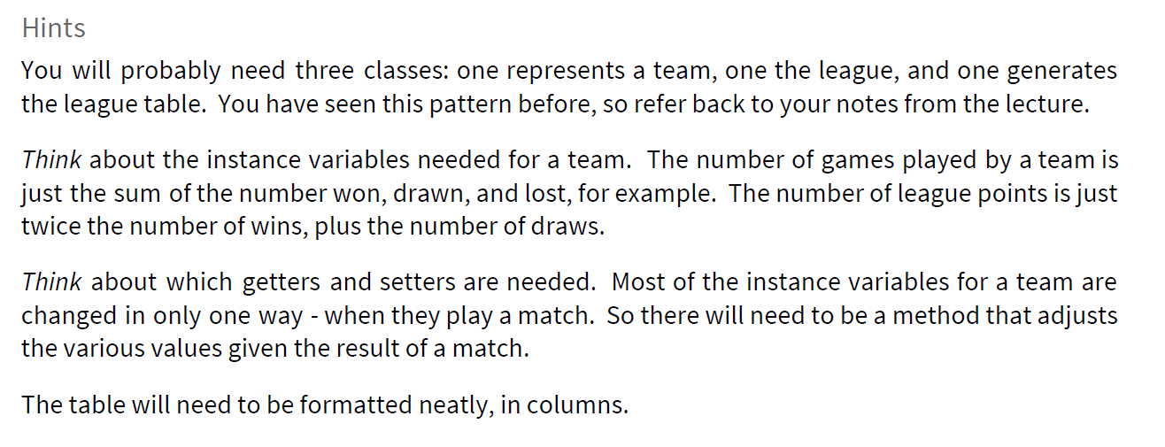
Check the hints
We put hints in for a reason, read and understand what they are and why we might need them?
It might not be necessary to have getters and setters for all attributes of a class, don’t just put them all in for the sake of it. Consider how you class may be used in future and if all getters and setters are needed?

Slide 6
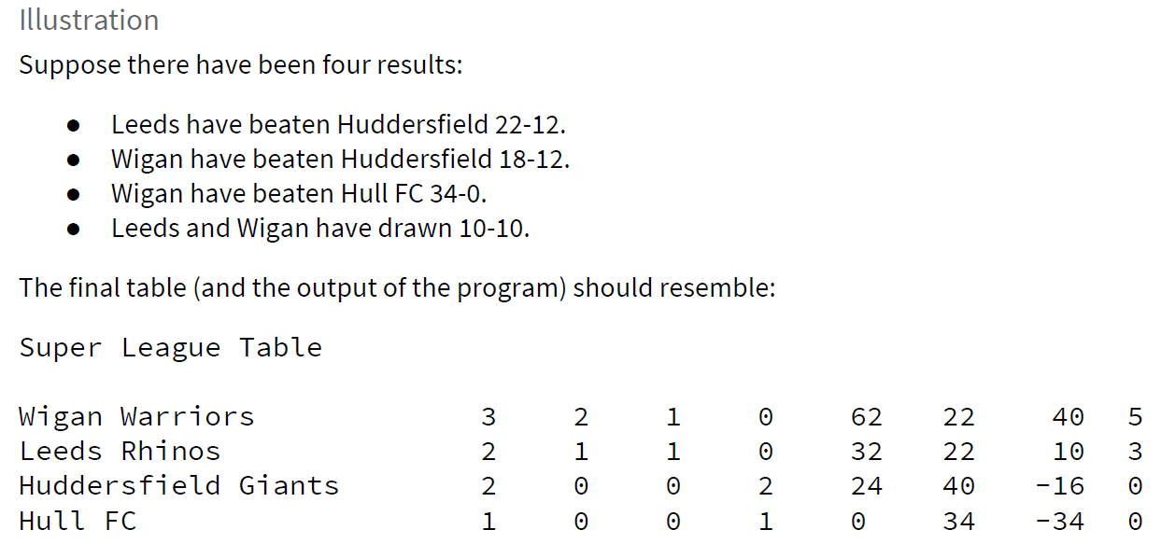
Further clues?
This is not a full set of results, perhaps you could add more?
Note it says should resemble, this doesn’t mean your output must be the same as the example?
Will all of these values will be required as attributes in our team class? Some of these values can be calculated from others. This is mentioned on the tutorial worksheet.

Slide 7
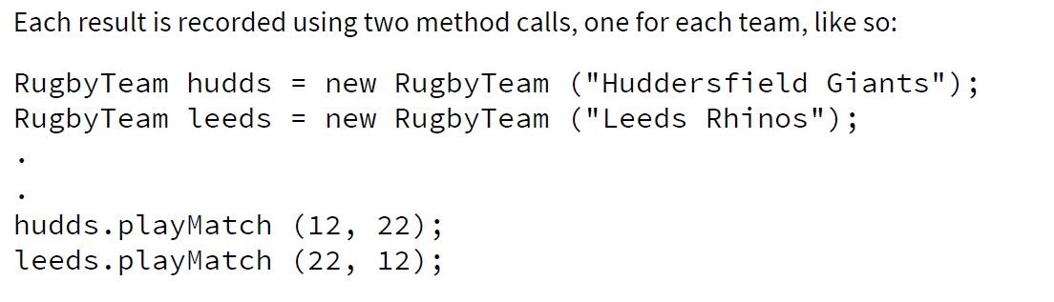
Even more clues!
This tells us that the constructer of a teams only require one value, the team name. Create an instance for each real team in the Super League
We can also see that that the team has a method to deal with playing matches, put such a method in the Team class
Each match requires a match entry for the home and away team, see that the values 12 and 22 are reversed.

Slide 8
Other Classes
The tutorial gives an indication as to the other classes needed for the programme as shown before.
The programme will need a single main method to be run, this should be in a class that does not represent the Team or the League.
All of the creating of Teams and the League should happen in the main method (exactly the same as the Poppleton Dogs home example).

Slide 9
Putting it all together
At this point you should have a good understanding the requirements of the tutorial question, have identified the necessary classes and the relationships between them.
The league will have an ArrayList which contains all of the Team Objects, the printing of the league table requires a loop and is the same as Cracker Packer and Dogs Home examples.
The techniques mentioned in this presentation can be viewed as modelling, combining this with UML can give you a very good understanding of the problem you are trying to solve.

Slide 10
Finally
Any questions about today’s session?
Continue with any unfinished tutorial work.

